Slide 1
Temporal Fusion Transformer: Predicting the future
Benjamin Kettner

Slide 2
About me
Proud father
Metalhead
Mathematician
Data platform MVP
CTO at ML!PA Consulting GmbH (Berlin, GER)
@DataMonsterBen
benjamin.Kettner@ml-pa.com

Slide 3
Why is timeseries prediction hard?
Variety of inputs:
Timeseries that are known in the past
Static (time-invariant) data
Known future inputs
Unknown interaction of inputs with target
Unknown seasonality in target
Limited trust in models due to transparency of algorithms (“What caused this prediction?”)

Slide 4
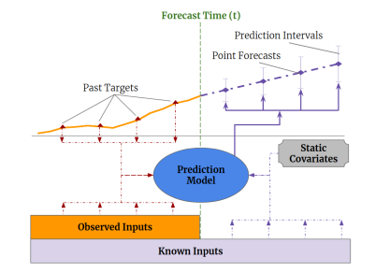
Input types
Image taken from https://arxiv.org/abs/1912.09363

Slide 5
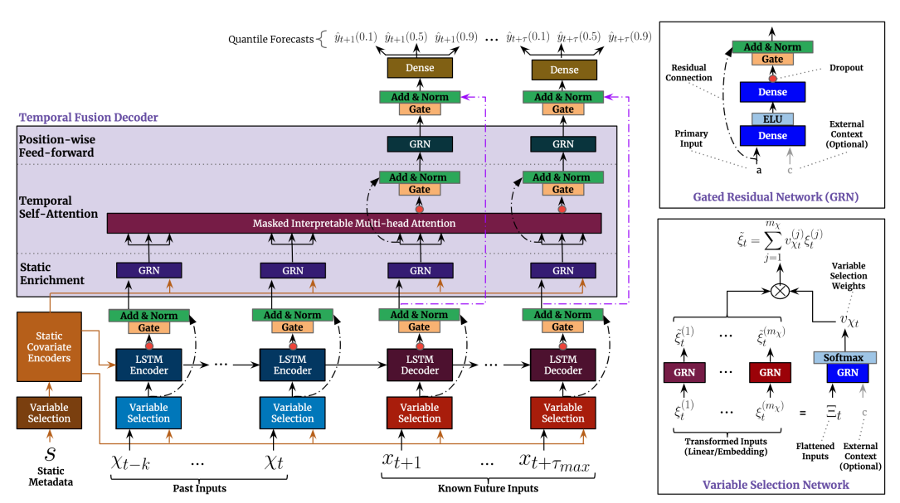
TFT Model architecture
Image taken from https://arxiv.org/abs/1912.09363

Slide 6
Components I
Variable selection networks:
Relevance and specific contribution of variables unknown
Removing unnecessary noisy inputs
Variable selection can improve performance

Slide 7
Components II
Gating:
Relationship between inputs and targets is unknown in advance
Extent of required non-linear processes is unknown
Flexibility to apply non-linear processes where needed
GRN in enrichment layer gives possibility to skip layers or suppress non-linear contribution

Slide 8
Components III
Static encoders
Integrate information from static metadata
Multi-Head Attention
Self-attention mechanism to learn long-term relationships across different time-steps (different seasonalities)
Enhance explainability

Slide 9
Components IV
Temporal fusion
Series of layers to learn temporal relationships
Local enhancement, relation of data with surrounding values
Static enhancement, static context without temporal dependence
Temporal self-attention to pick up long-range dependencies

Slide 10
Demos
To use jupyter in docker:
docker run -it --rm -p 10000:8888 -v ${PWD}:/home/jovyan/work jupyter/datascience-notebook

